Slide 1
Indo-Japan Startup Collaboration
Japan External Trade Organization
JETRO Bengaluru
August 2023

Slide 2
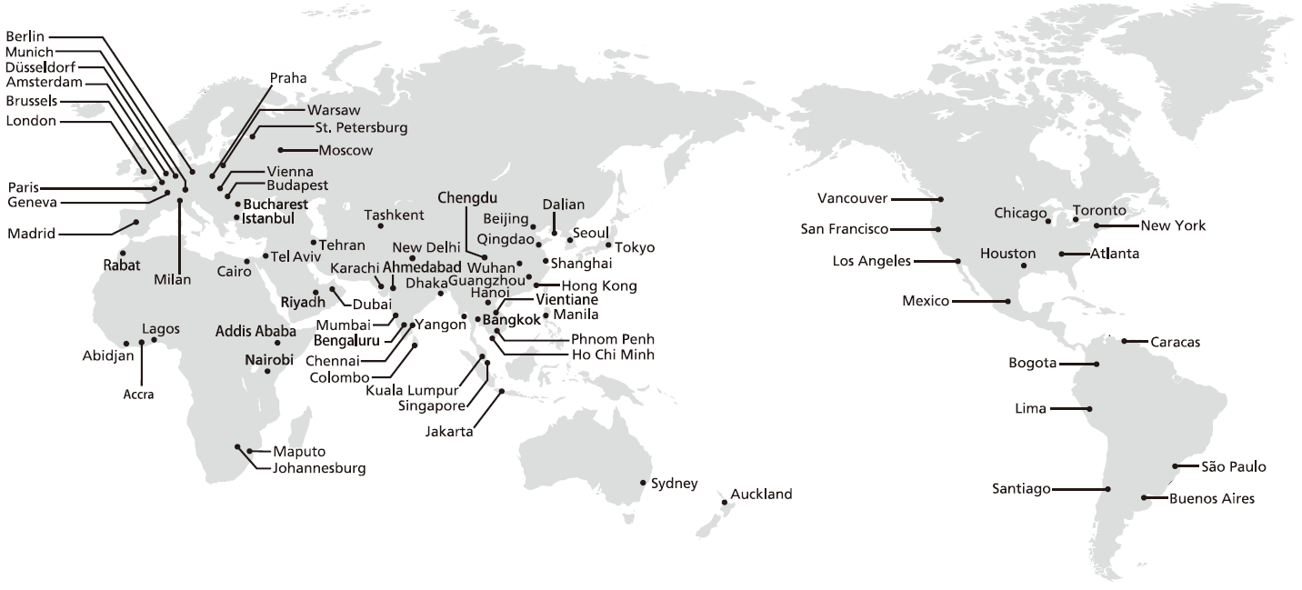
JETRO: Who We Are
Japan External Trade Organization (JETRO)
Japanese government-related organization promoting trade and investment
Originally established in 1958
50+ domestic offices & 70+ international offices in 55 countries

Slide 3
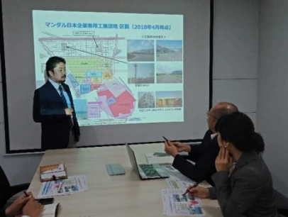
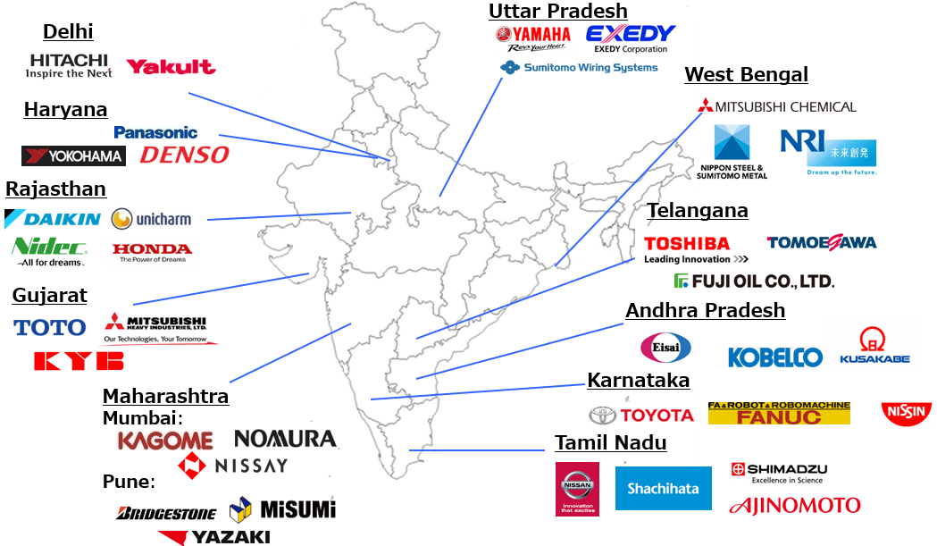
One-stop window for Japanese Companies coming to India / already existent in India
We have a one-stop window for various queries from Japanese companies interested in investing in India. We also work on behalf of 1,400+ Japanese companies in India to propose enhancement of business environment to the Indian government.
For New Japanese Companies
We receive queries from Japanese companies on daily basis and give them individual advices / consultations both offline and online.
We operate Business Support Center Ahmedabad（BSCA）as a total support center for Japanese companies planning to invest in India
For Japanese Companies in India
We also give advices / consultations to the Japanese companies in India on daily basis.
We work with legal / accounting firms in India to for those who need professional queries.
We collaborate with JCCII (Japan Chamber of Commerce and Industry in India) to compile proposals for business environment enhancement in India.

Slide 4
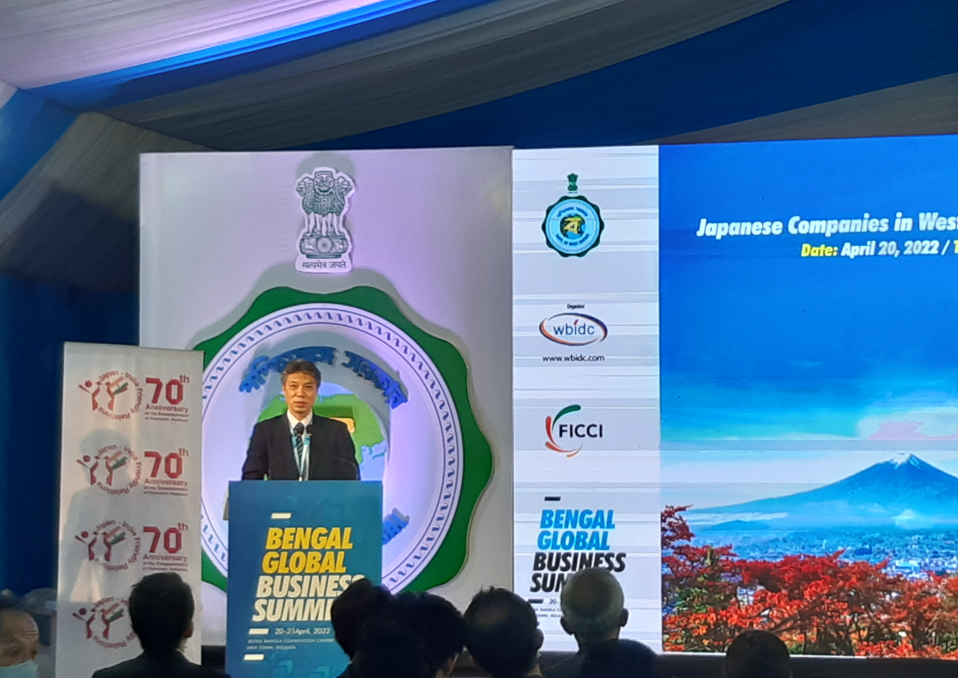
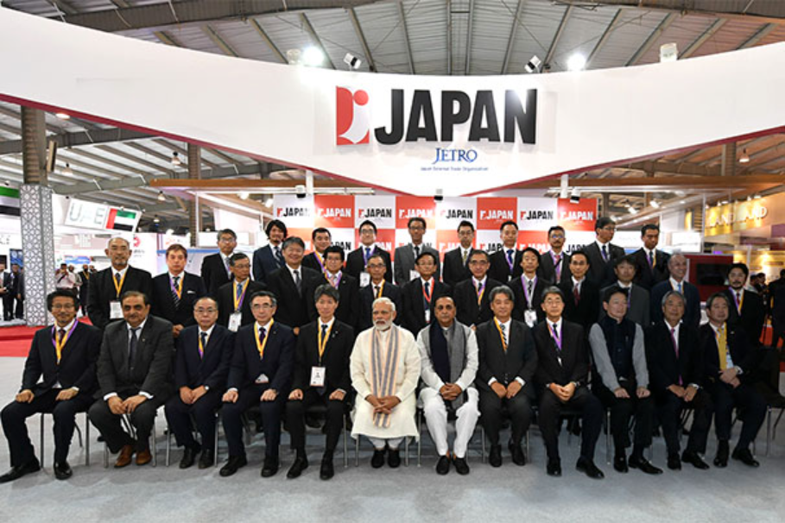
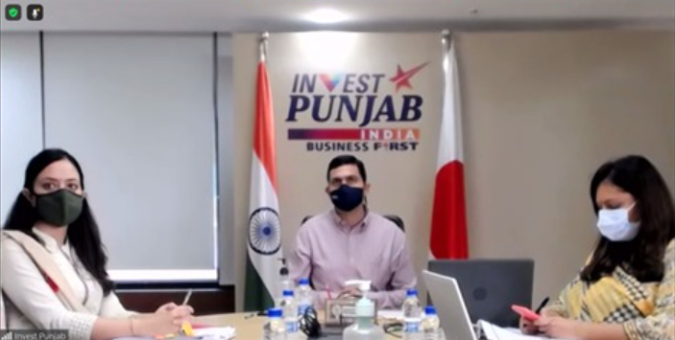
Working Together with State Governments
We work closely with the state governments in India for our mutual goal to assist Japanese companies to invest in India.
We work together with state governments:
Collaborate as a partner organization in investment summits hosted by the state governments, including organizing country pavilions and seminars.
Support business missions / roadshows in Japan hosted by the state governments.
Organize investment seminars in Japan.

Slide 5
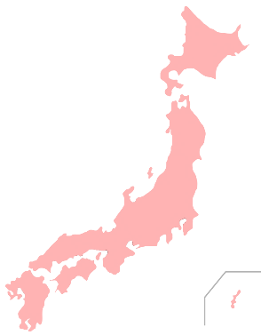
Invest Japan & Cross-Border Open Innovation
We support Indian companies to invest and start business in Japan.
We also support creation of collaboration between Indian startups and Japanese companies.
Invest Japan Program
We support Indian companies to invest and expand their business in Japan.
We provide one-stop services from Tokyo and 5 other regional cities with temporary office space, consultation from professionals and giving networking opportunities with new Japanese companies.
DX (Cross-Border Open Innovation) Program
We facilitate collaboration between Japanese and foreign companies. (Business alliances including technical cooperation, joint R&D, and M&A, etc.)
We support cross-border open innovation for accelerating digital and green transformation.
We have prominent technologies or business models!
We want to develop new business through collaborations.
Company Introductions
Pitching Events
One-on-One meetings
Indian Startups
Japanese Companies

Slide 6
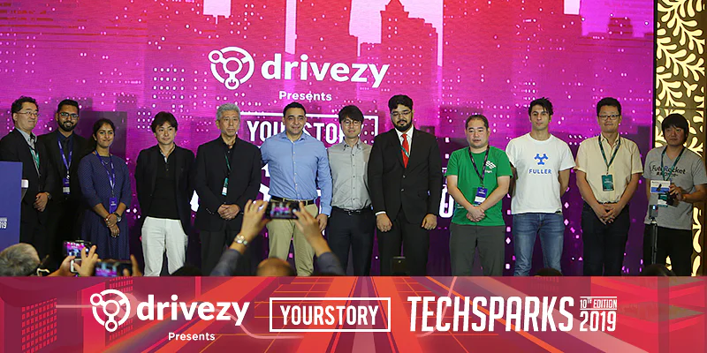
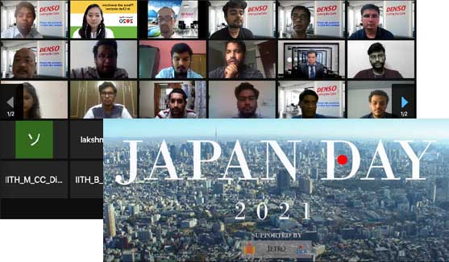
Japan - India Startup Hub Activities
Gov. of India and Japan agreed to the “Japan-India Digital Partnership“ in 2018.
We promote collaboration between the Japanese and Indian startup ecosystems to foster innovation.
Global Acceleration Hub
We established “Global Acceleration Hub” to support the collaboration and expansion of Japanese startups in partnership with the ecosystem of India.
We also support connections between startups and governments, accelerators, incubators, academia, etc.
Inviting highly skilled human resources – Japan Day @ IIT-Hyderabad
We support creating innovation through the recruitment of high-level human resources in India.
Since 2018, we have held job matching events with IIT-Hyderabad and other universities, between Japanese companies and Indian students.

Slide 7
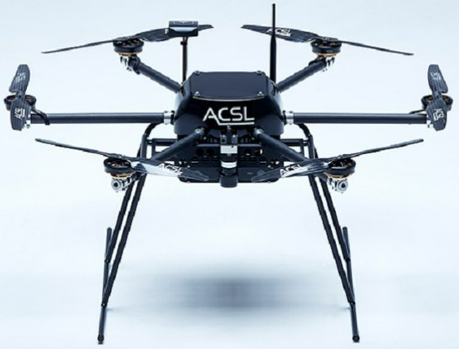
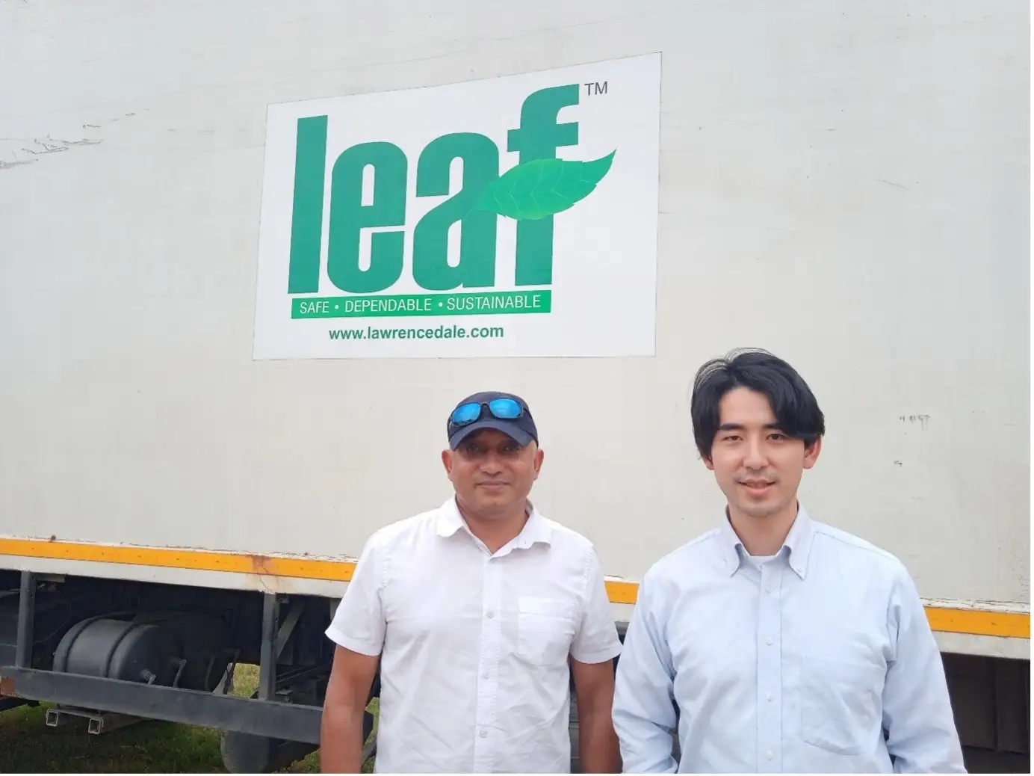
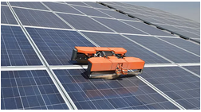
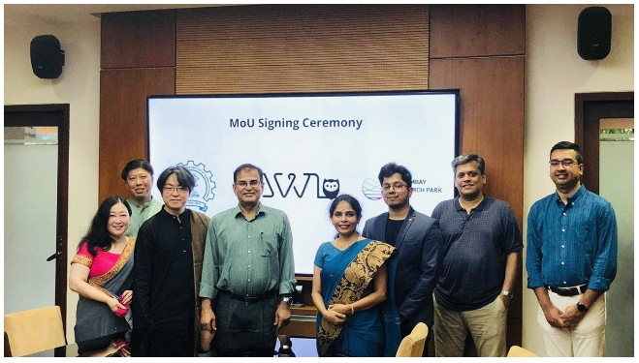
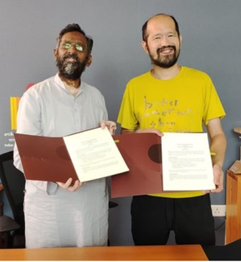
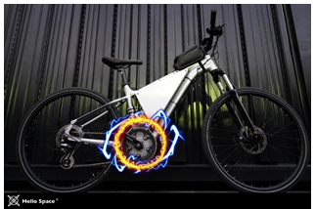
Japanese startup - India collaborations
【Agritech】 Sagri×Leaf
【Robotics】 Mirai Kikai×
Jetsons Robotics
【Drone】 ACSL×Aeroarc
【AI】 I’mbesideyou×
IIT-Hyderabad
【Ebike, Autoonmous】 HelloSpace×IIT-H
【AI】 AWL×IIT-Bombey

Slide 8
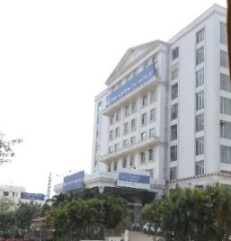
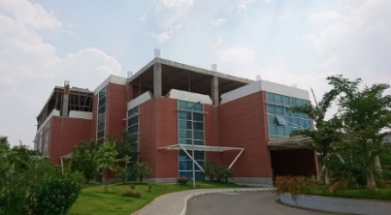
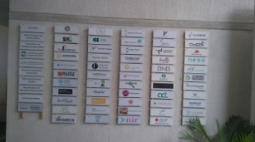
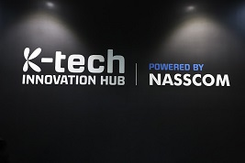
Collaborations with key player in Startup ecosystem
Mazumdar Shaw Medical Foundation
Centre for Cellular and Molecular Platforms
(C-CAMP)
Bangalore Bioinnovation Centre（BBC)
NASSCOM Centre Of Excellence
(CoE)-IoT
Micelio Mobility Private Limited
8

Slide 9
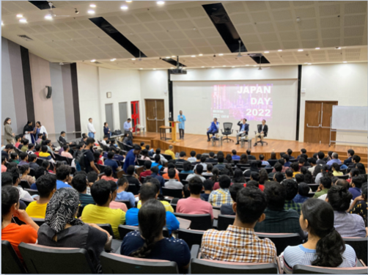
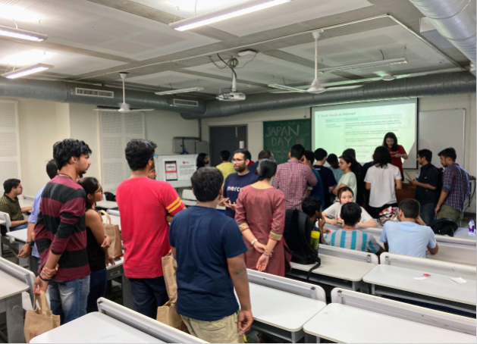
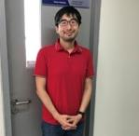
Job Fair in Indian Institute of Technology Hyderabad
Since 2018 , JETRO has been holding job fairs (company information sessions) at the Indian Institute of Technology Hyderabad so that Japanese companies can hire highly skilled Indian human resources who have the potential to play an active role in the world .
○ Indian Institute of Technology Hyderabad ( IITH ):
An engineering and science and technology university established with support from the Japanese government
Ranked
○ Company information session ( JAPAN DAY ) :
Since 2018 , JETRO , IIT-H , and JICA have been co-sponsor of job fairs to give information on Japanese companies.
In 2021, in addition to the job fair, the “ Japan-India Industry-Academia-Government Collaboration Promotion Session” was held at the same time to match Japanese companies considering joint research with laboratories of IIT-H.
2022 , The job fair was held at campus for the first time in three years. Presentations from Japanese companies in the morning, and an exchange session with students in the afternoon. Alumni who graduated from IITH and work for Japanese companies also took the stage and introduced their experiencel of working in Japan.

Slide 10
Many Japanese companies are in the automotive industry
In the automobile field, mainly each manufacturer, andd their suppliers are also entering the market. In recent years, retail sales and restaurants are also on the rise.
15 % of the number of Japanese companies operating in the country is SMEs .
Percentage of industry in number of Japanese companies in India
・Electrical appliance (household appliances and industrial use)
・Finance (banking/insurance)
・Chemical , medical related (medical equipment, pharmaceuticals)
Automobiles and automobiles parts account for 10 %
·Industrial machinery
・Electricity/Electronics
・Chemicals, etc.
Non-automotive fields also:
・Renewable energy
・Environment related business
・Food processing , etc.
Service industry ratio is on the rise :
・Retail
・Food processing
・Eating out
( Source) Embassy of Japan in India and JETRO “List of Japanese companies operating in India ( as of October 2021 )”

Slide 11
Japanese Industrial Townships（JITs）
Jhajjar (Reliance)
※丸紅が営業支援
Haryana
Ghiloth Industrial Park
Rajasthan
Greater Noida
Uttar Pradesh
Neemrana Industrial Park
Rajasthan
Sri City
(Navayuga Group)
※豊田通商が営業支援
Andhra Pradesh
Mandal Industrial Park
※豊田通商がレンタル工場を運営
Gujarat
ORIGINS, Chennai
(住友商事 / Mahindra)
Tamil Nadu
OneHub Chennai Industrial Park
(CapitaLand)
Tamil Nadu
Supa Industrial Park
Maharashtra
双日 – Motherson Industrial Park
Tamil Nadu
（注）青色の箇所はジェトロが入居支援に
直接関与する工業団地
Tumkur
Karnataka

Slide 12
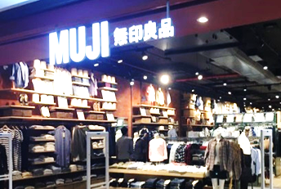
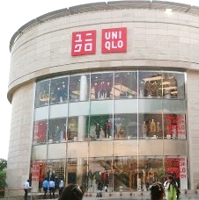
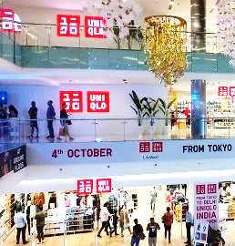
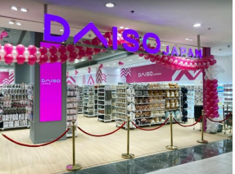
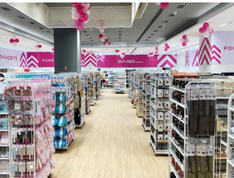
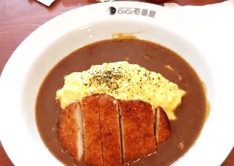
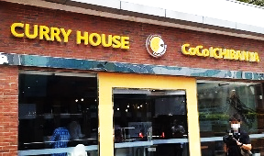
Expansion of Japanese retail and restaurant business
UNIQLO
MUJI
・The first store opened in New Delhi in 2019
・Currently, there are a total of 10 stores in the Delhi metropolitan area .
Since 2016, Currently in New Delhi, Mumbai, Noida
Daiso
CoCo. Ichibanya
In 2022, First store is opened in Chandigarh. Currently 6 stores opened in whole India.
In 2020 , Curry House CoCo Ichibanya firstlly opened in Gurugram . The second store opened in Delhi in October 2022.
(source) Taken by JETRO or from the company

Slide 13
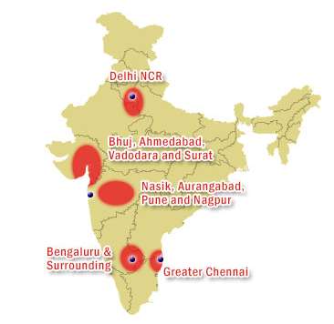
Trends in Japanese companies in Karnataka
In the manufacturing industry, manufacturing of automobiles (two-wheeled and four-wheeled vehicles) and industrial machinery have a majority. Recently, business development for innovation and research and development in the digital field have also been increasing.
【Number of Japanese companies】
✔537 Basis（2022）
✔Whole India:4,901 Basis（2022）
2022
2011
Maharashtra
Haryana
Tamil Nadu
Karnataka
Gujarat
Delhi
Uttar Pradesh
West Bengal
Rajasthan
Telangana
Andhra Pradesh
Kerala
Madhya Pradesh
(773)
(589)
(579)
(537)
(358)
(313)
(306)
(212)
(181)
(161)
(124)
(119)
(115)
(218)
( - )
(286)
(182)
( 29)
(385)
( 51)
( 67)
( 29)
( - )
( 70)
( 47)
( 7)
List of Japanese companies operating in India October 2022 Embassy of Japan in India, JETRO

Slide 14
Trends in Japanese companies in Karnataka
【Manufacturing Sector】
Mainly Centered on automotive industry
✔two-wheeled and four-wheeled vehicles
✔industrial machineries/equipment
【Service Sector】
IT business development
Research and Development in digital field
【Factory】
Mainly located in industrial parks, developed by KIADB.
【Office branch】
Mainly located in city areas

Slide 15
Trends in Japanese companies in Karnataka
Vasantha Narsapura
Peenya & Rajajinagar
Hikoki Power Tools India
Hightemp Furnaces
Mitsubishi Electric India
MMC Hardmetal
Mirapro India
DMG Mori
TMEIC Brother Hitachi Astemo
Doddaballapura
Musashi India
Keihin Fie
Simplex Naigai Castings
Sakata Seed India
Takii Seeds India
Tokita Seed India
Narasapura
Honda Motorcycle & Scooter India
Aisin Karnataka
Exedy Clutch India
Jey Ushin
Dabaspet
White Field
Toyo Denki Power Systems
Tokai Rika Minda
Hitachi Terminal Solutions
Makino India
Nihon Technology
NTT Data
Malur
Yuken India
NPR Auto parts
Tsujikawa India
Tokai Imperial Hydraulics India
Vemagal
Mitsubishi Elevator India

Slide 16
Trends in Japanese companies in Karnataka
Bidadi
Jigani
Bommasandra
Toyota Kirloskar Motor
Toyota Tsusho India
Toyota Kirloskar Auto Parts
Toyota Techno Park India
Toyotetsu India Auto Parts
Toyoda Gosei South India
Owari Precision Products
Asahi India Glass
JTEKT Sona Automotive India
Motherson Sumi Systems
AT India Auto Parts
TT Steel Service India
Cataler India Auto Parts
Elliott Ebara Turbomachinery
TT Recycling Management Industries
Maruichikuma Steel Tube
WIPRO Kawasaki Precision Machinery
Sango India Automotive Parts
JBM Ogihara Automotive India
Minda Kyoraku
Transystem Logistic International
Toyota Logistics Kishor India
Kirloskar Toyota Textile Machinery
Toyota Industries Engine India
Indo Nissin Foods
Shindengen India
Yazaki India
Medreich R&D Center(Meiji Seika)
Arvind Goodhill Suit Manufacturing
Kitagawa India
Semitec Electronics India
Electronic City
Yokogawa India Yaskawa India Fanuc India Netmagic IT Service
Harohalli
Tokai Rubber Auto Parts India
Kawasaki MK Industries India

Slide 17
Thank you

